Slide 1
Inference in First Order Logic
Md Mehrab Hossain Opi
CSE 4109: Artificial Intelligence

Slide 2
Propositional vs FOL Inference
First order inference can be done by converting the knowledge base to propositional logic and using propositional inference.

Slide 3
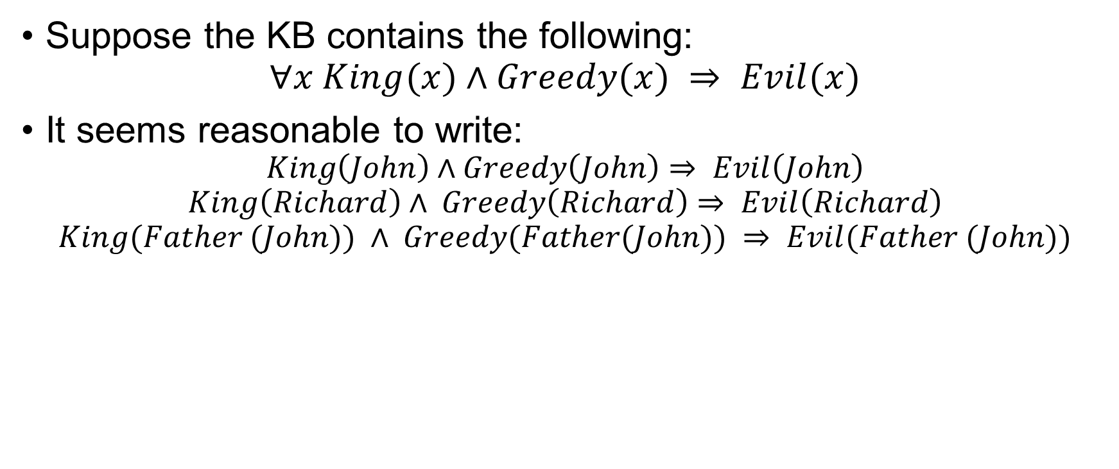
Inference Rule for Quantifiers
Suppose the KB contains the following:
$$∀x King(x)∧Greedy(x) ⇒ Evil(x)$$
It seems reasonable to write:
$$King\left(John\right)∧Greedy\left(John\right)⇒ Evil\left(John\right)$$
$$King\left(Richard\right)∧ Greedy\left(Richard\right)⇒ Evil\left(Richard\right)$$
$$King(Father (John)) ∧ Greedy(Father(John)) ⇒ Evil(Father (John))$$

Slide 4
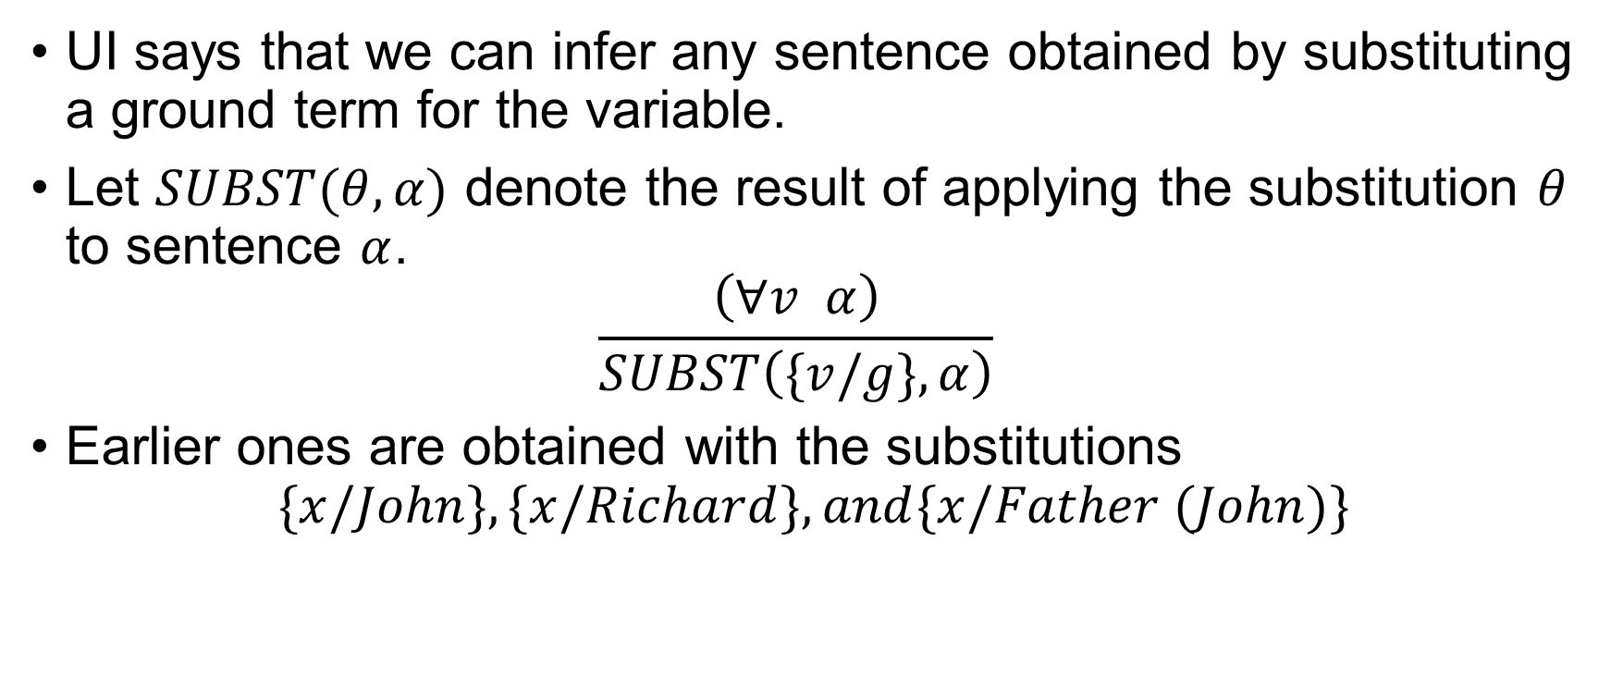
Universal Instantiation (UI)
UI says that we can infer any sentence obtained by substituting a ground term for the variable.
Let $SUBST(θ, α)$ denote the result of applying the substitution $θ$ to sentence $α$. $\frac{\left(∀v α\right)}{SUBST\left(\{v/g\},α\right)}$
Earlier ones are obtained with the substitutions
$$\{x/John\}, \{x/Richard\},and\{x/Father (John)\}$$
Apply the substitution {v/g}
to the expression α

Slide 5
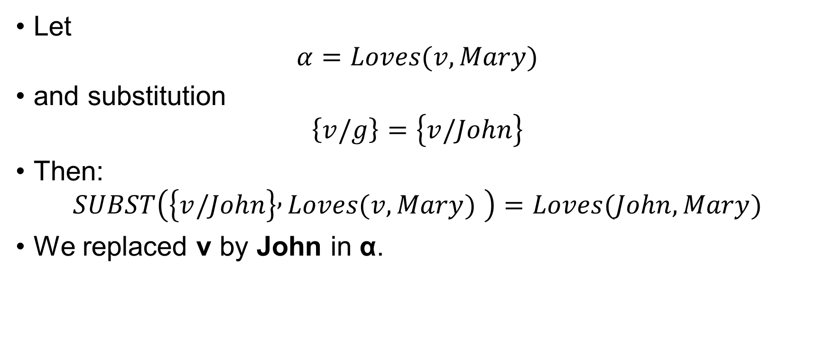
Universal Instantiation (UI)
Let
$$α=Loves(v, Mary)$$
and substitution
$$\left\{v/g\right\}=\left\{v/John\right\}$$
Then:
$$SUBST\left(\left\{v/John\right\} , Loves(v, Mary) \right)=Loves(John, Mary)$$
We replaced v by John in α.

Slide 6
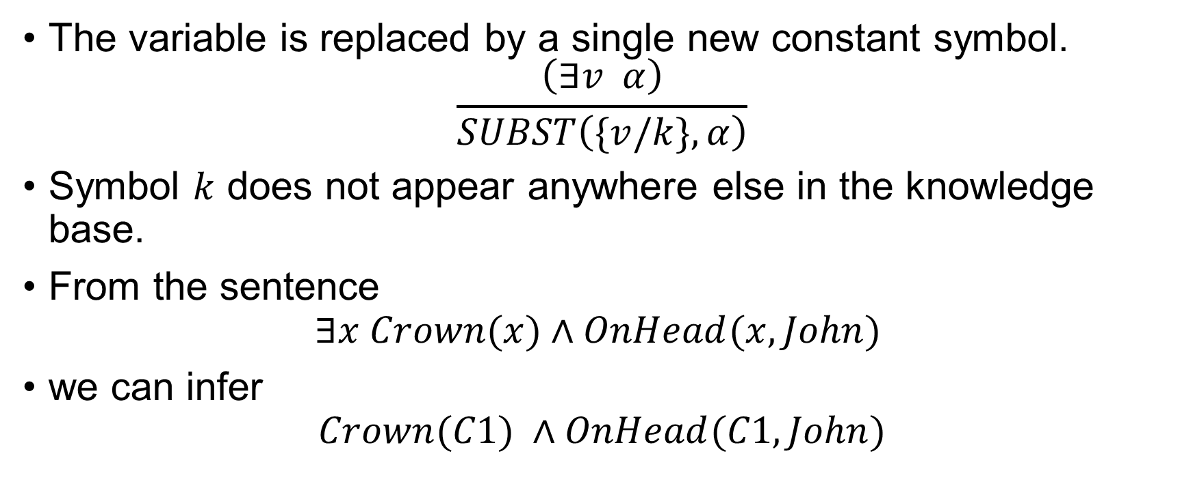
Existential Instantiation
The variable is replaced by a single new constant symbol. $\frac{\left(∃v α\right)}{SUBST\left(\{v/k\},α\right)}$
Symbol $k$ does not appear anywhere else in the knowledge base.
From the sentence
$$∃x Crown(x)∧OnHead(x,John)$$
we can infer
$$Crown(C1) ∧OnHead(C1,John)$$

Slide 7
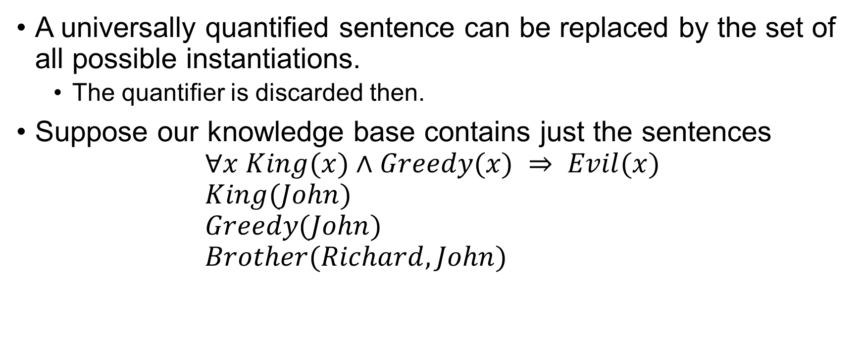
Reduction to Propositional Inference
A universally quantified sentence can be replaced by the set of all possible instantiations.
The quantifier is discarded then.
Suppose our knowledge base contains just the sentences $∀x King(x)∧Greedy(x) ⇒ Evil(x)$ $King(John)$ $Greedy(John)$ $Brother(Richard,John)$

Slide 8
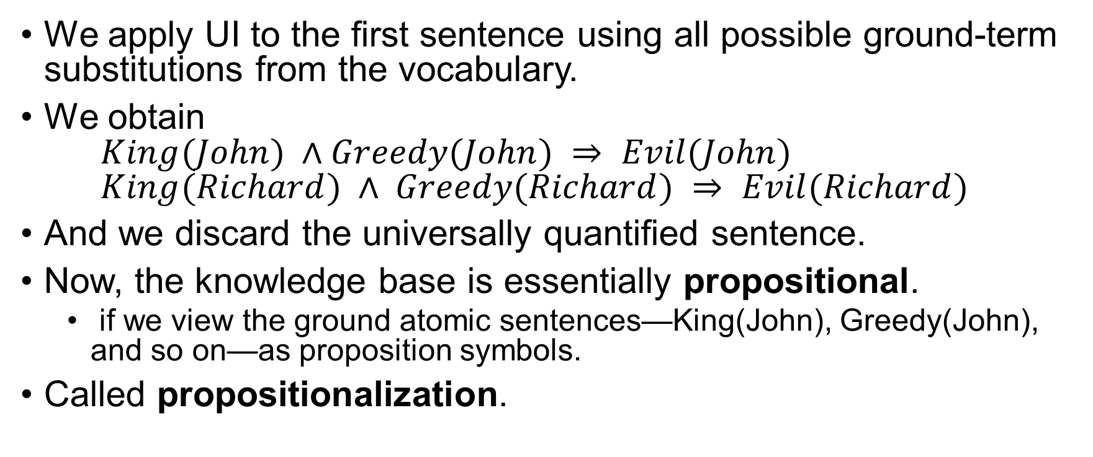
Reduction to Propositional Inference
We apply UI to the first sentence using all possible ground-term substitutions from the vocabulary.
We obtain $King(John) ∧Greedy(John) ⇒ Evil(John)$ $King(Richard) ∧ Greedy(Richard) ⇒ Evil(Richard)$
And we discard the universally quantified sentence.
Now, the knowledge base is essentially propositional.
if we view the ground atomic sentences—King(John), Greedy(John), and so on—as proposition symbols.
Called propositionalization.

Slide 9
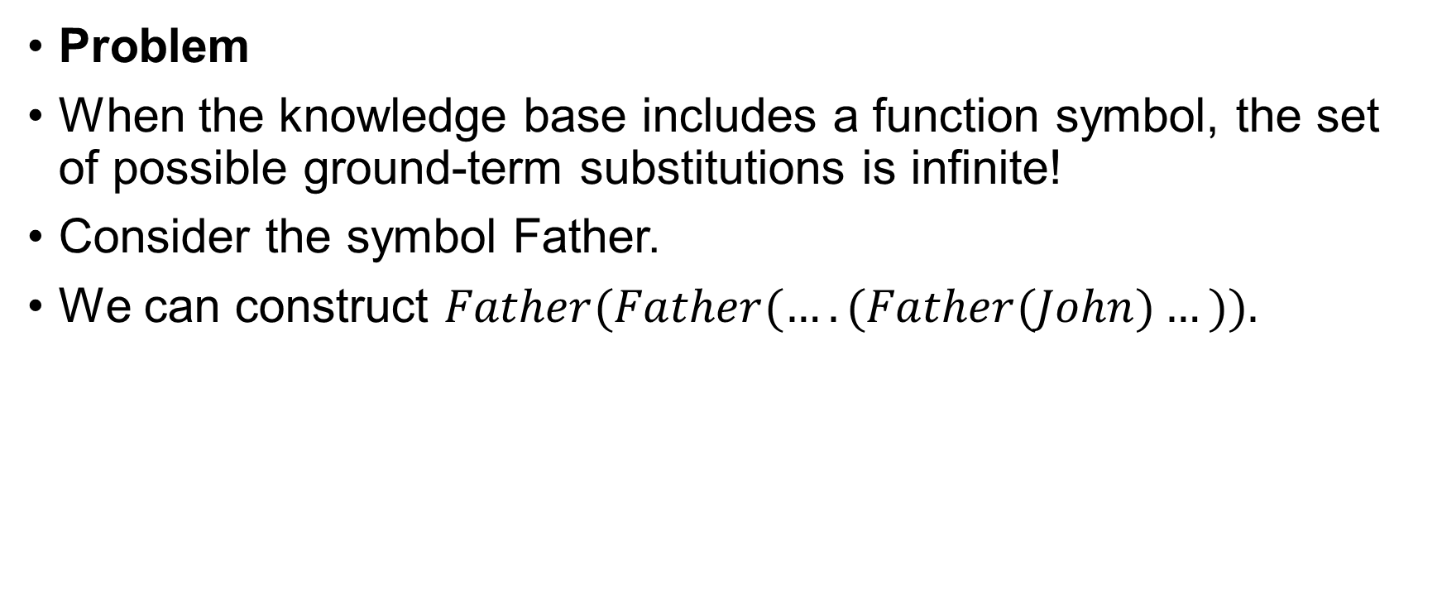
Reduction to Propositional Inference
Problem
When the knowledge base includes a function symbol, the set of possible ground-term substitutions is infinite!
Consider the symbol Father.
We can construct $Father(Father(….(Father(John)…)).$

Slide 10
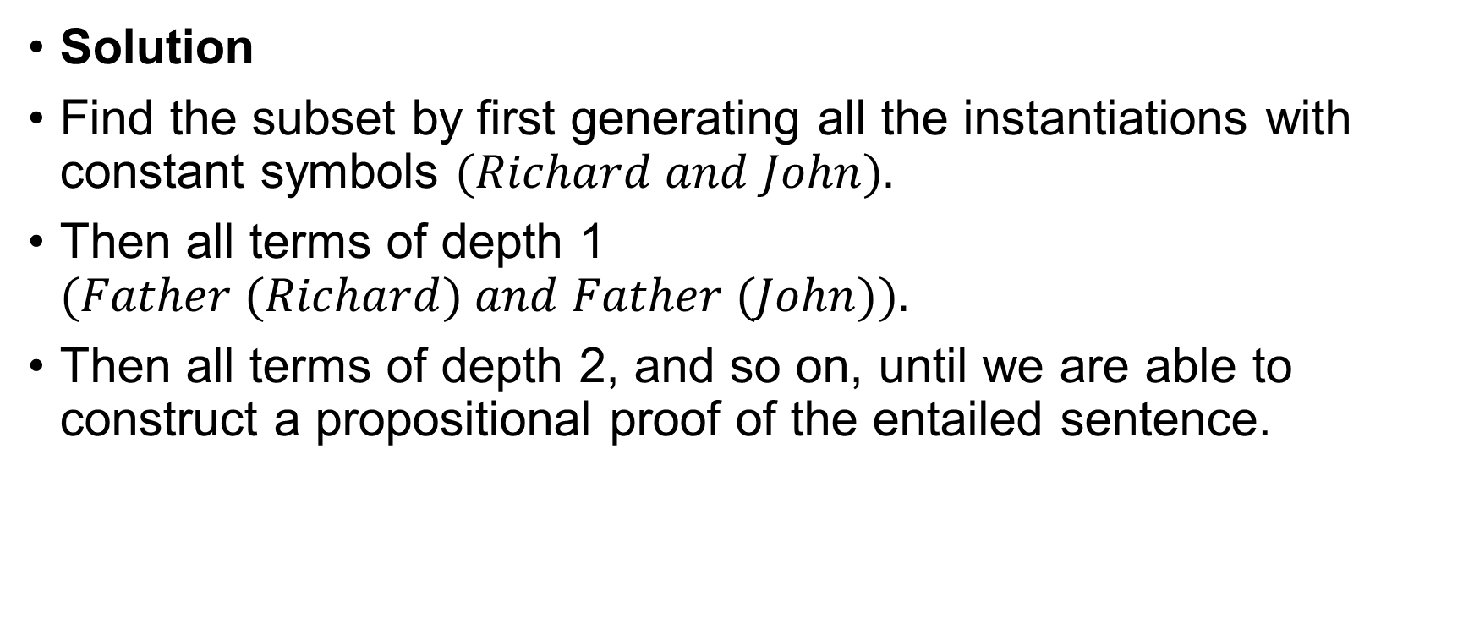
Reduction to Propositional Inference
Solution
Find the subset by first generating all the instantiations with constant symbols $(Richard and John).$
Then all terms of depth 1 $(Father (Richard) and Father (John)).$
Then all terms of depth 2, and so on, until we are able to construct a propositional proof of the entailed sentence.

Slide 11
Reduction to Propositional Inference
Any entailed sentence can be proved.
What happens when the sentence is not entailed?
Can we tell?
Well, for first-order logic, it turns out that we cannot.
The question of entailment for FOL is semidecidable.
Algorithms exist that say yes to every entailed sentence, but no algorithm exists that also says no to every non-entailed sentence.

Slide 12

Unification and Lifting
Consider the sentences: $∀ x King(x) ∧ Greedy (x) ⇒ Evil(x)$
$$King\left(John\right) \\ ∀y Greedy(y)$$
How do you prove John is evil?

Slide 13

Generalized Modus Ponens
For atomic sentences $p_{i}, p_{i}^{′}, and q,$ where there is a substitution $θ$ such that $SUBST\left(θ, p_{i}^{′}\right)=SUBST\left(θ,p_{i}\right)$for all $i$, $\frac{p_{1}^{′}, p_{2}^{′},…, p_{n}^{′}, \left(p_{1}∧p_{2}∧…∧p_{n}⇒q\right)}{SUBST\left(θ, q\right)}$

Slide 14
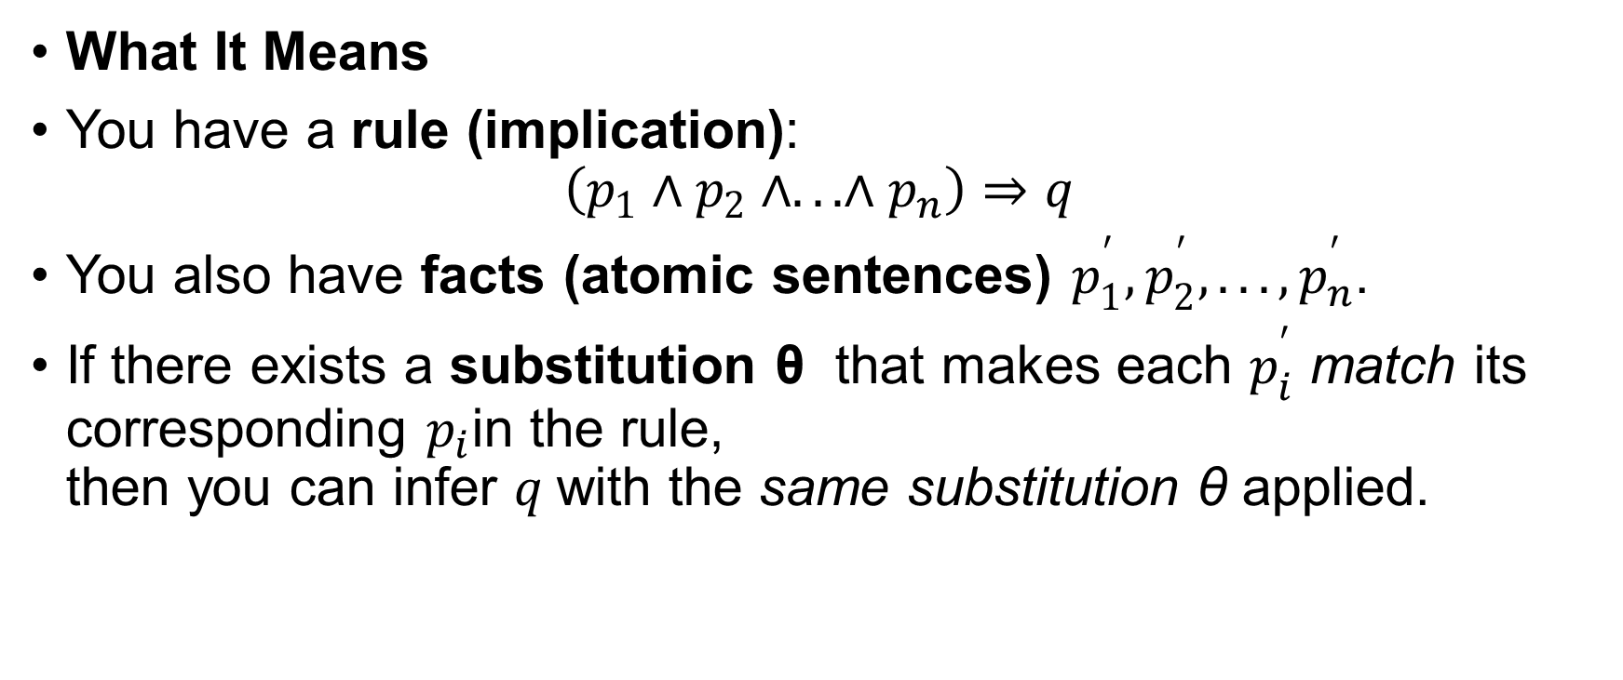
Generalized Modus Ponens
What It Means
You have a rule (implication):
$$\left(p_{1}∧p_{2}∧...∧p_{n}\right)⇒q$$
You also have facts (atomic sentences) $p_{1}^{′},p_{2}^{′},...,p_{n}^{′}$.
If there exists a substitution θ that makes each $p_{i}^{′}$ match its corresponding $p_{i}$in the rule, then you can infer $q$with the same substitution θ applied.

Slide 15
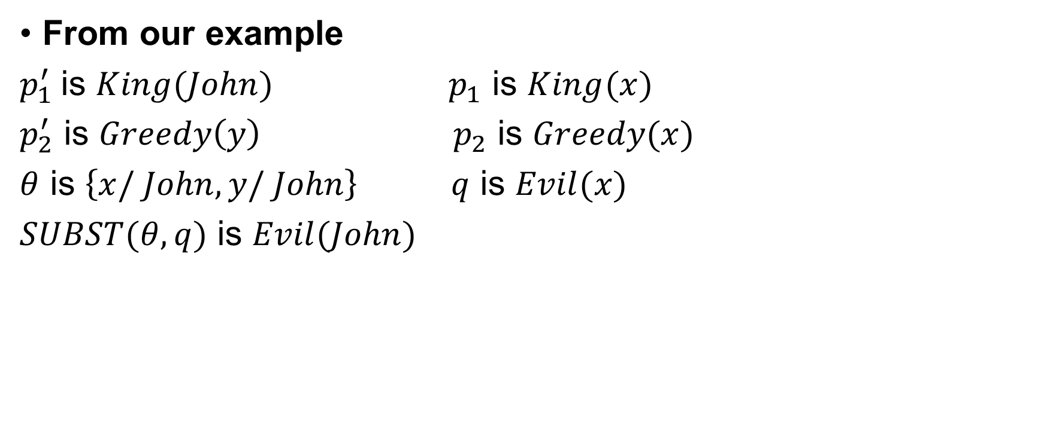
Unification and Lifting
From our example
$p_{1}^{′}$is $King(John)$ $p_{1}$ is $King(x)$
$p_{2}^{′}$ is $Greedy\left(y\right) p_{2}$ is $Greedy(x)$
$θ$ is $\left\{x/ John, y/ John\right\} q$ is $Evil(x)$
$SUBST(θ, q)$ is $Evil(John)$

Slide 16
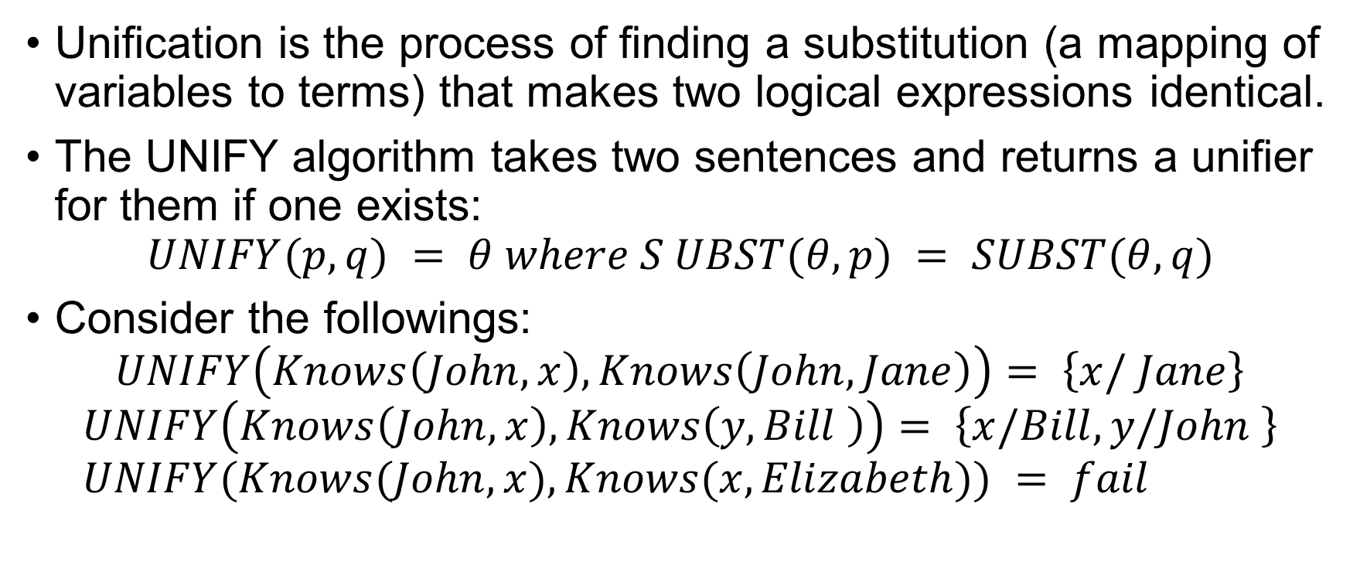
Unification
Unification is the process of finding a substitution (a mapping of variables to terms) that makes two logical expressions identical.
The UNIFY algorithm takes two sentences and returns a unifier for them if one exists:
$$UNIFY(p, q) = θ where S UBST(θ, p) = SUBST(θ, q)$$
Consider the followings: $UNIFY\left(Knows\left(John, x\right), Knows\left(John, Jane\right)\right)= \left\{x/ Jane\right\}$
$$UNIFY\left(Knows\left(John, x\right), Knows\left(y, Bill \right)\right)= \left\{x/Bill,y/John \right\} \\ UNIFY(Knows(John, x), Knows(x, Elizabeth)) = fail$$

Slide 17
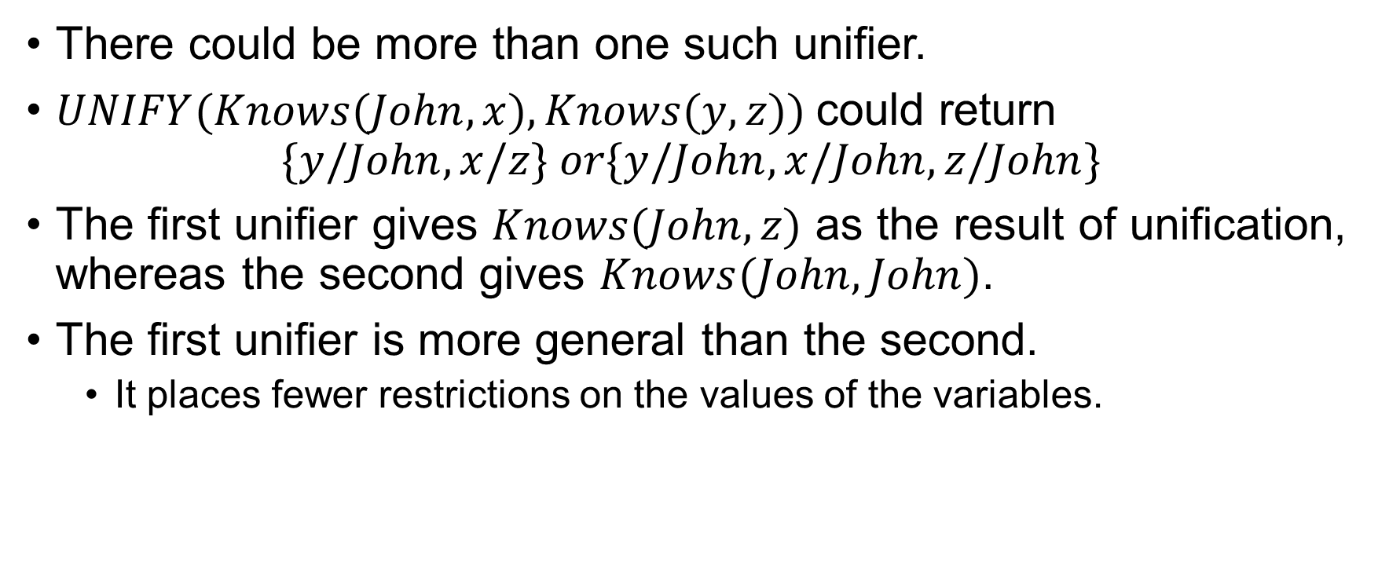
Unification
There could be more than one such unifier.
$UNIFY(Knows(John, x), Knows(y, z))$could return $\{y/John, x/z\} or\{y/John, x/John, z/John\}$
The first unifier gives $Knows(John, z)$ as the result of unification, whereas the second gives $Knows(John, John)$.
The first unifier is more general than the second.
It places fewer restrictions on the values of the variables.

Slide 18
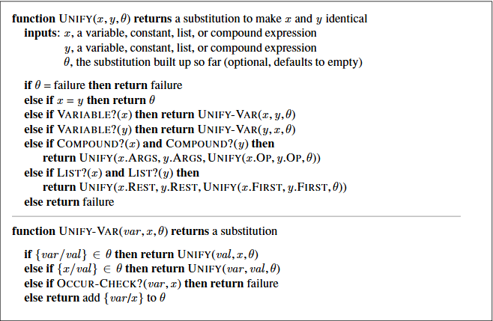
The unification algorithm

Slide 19
Forward Chaining
In propositional logic Start with the atomic sentences in the knowledge base and apply Modus Ponens in the forward direction, adding new atomic sentences, until no further inferences can be made.

Slide 20
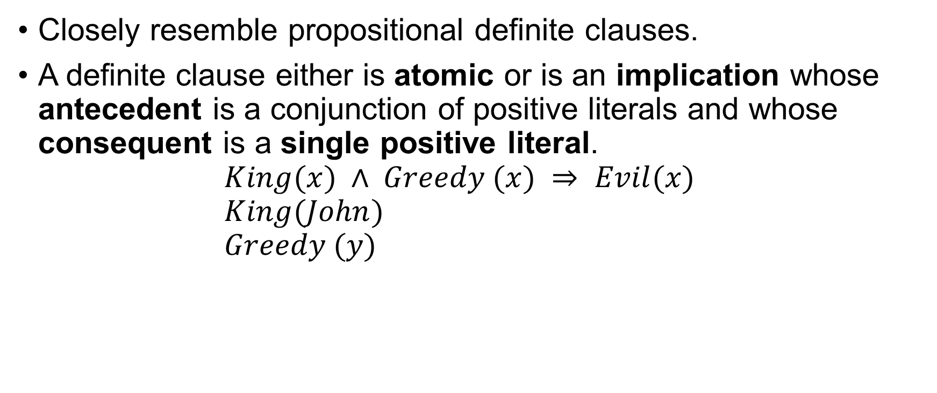
First-order definite clauses
Closely resemble propositional definite clauses.
A definite clause either is atomic or is an implication whose antecedent is a conjunction of positive literals and whose consequent is a single positive literal. $King(x) ∧ Greedy (x) ⇒ Evil(x)$ $King(John)$ $Greedy (y)$

Slide 21
First-order definite clauses
First-order literals can include variables.
Not every knowledge base can be converted into a set of definite clauses because of the single-positive-literal restriction, but many can.

Slide 22
First-order definite clauses
Consider the following “The law says that it is a crime for an American to sell weapons to hostile nations. The country Rusha, an enemy of America, has some missiles, and all of its missiles were sold to it by Colonel West, who is American.”
We need to prove “West is a criminal”.

Slide 23

First-order definite clauses
First, we will represent these facts as first-order definite clauses.
“it is a crime for an American to sell weapons to hostile nations”. $American(x) ∧ Weapon(y) ∧ Sells(x, y, z) ∧ Hostile(z) ⇒ Criminal (x)$

Slide 24
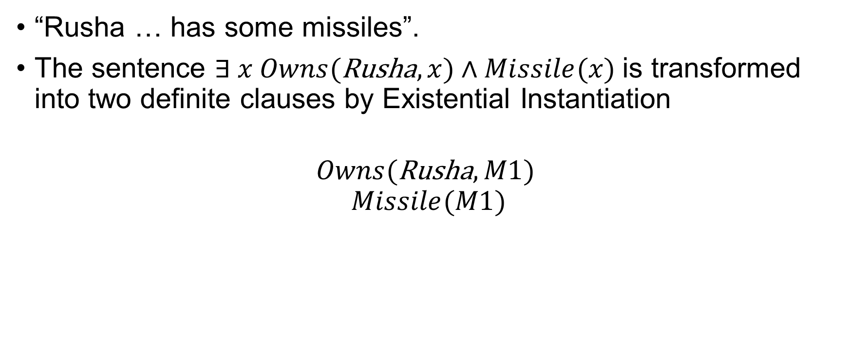
First-order definite clauses
“Rusha … has some missiles”.
The sentence $∃ x Owns(\text{Rusha}, x)∧Missile(x)$is transformed into two definite clauses by Existential Instantiation
$$Owns(\text{Rusha}, M1)$$
$$Missile(M1)$$

Slide 25
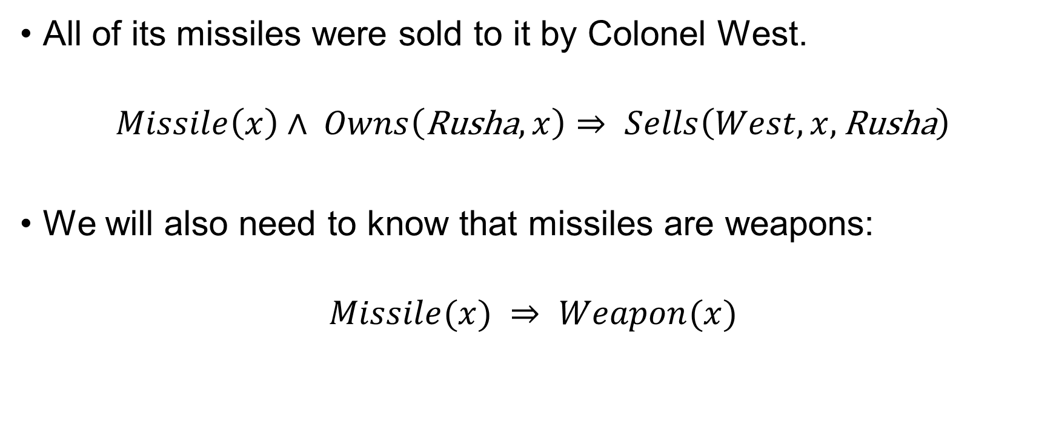
First-order definite clauses
All of its missiles were sold to it by Colonel West.
$$Missile\left(x\right)∧ Owns\left(\text{Rusha}, x\right)⇒ Sells\left(West, x,\text{Rusha}\right)$$
We will also need to know that missiles are weapons:
$$Missile(x) ⇒ Weapon(x)$$

Slide 26
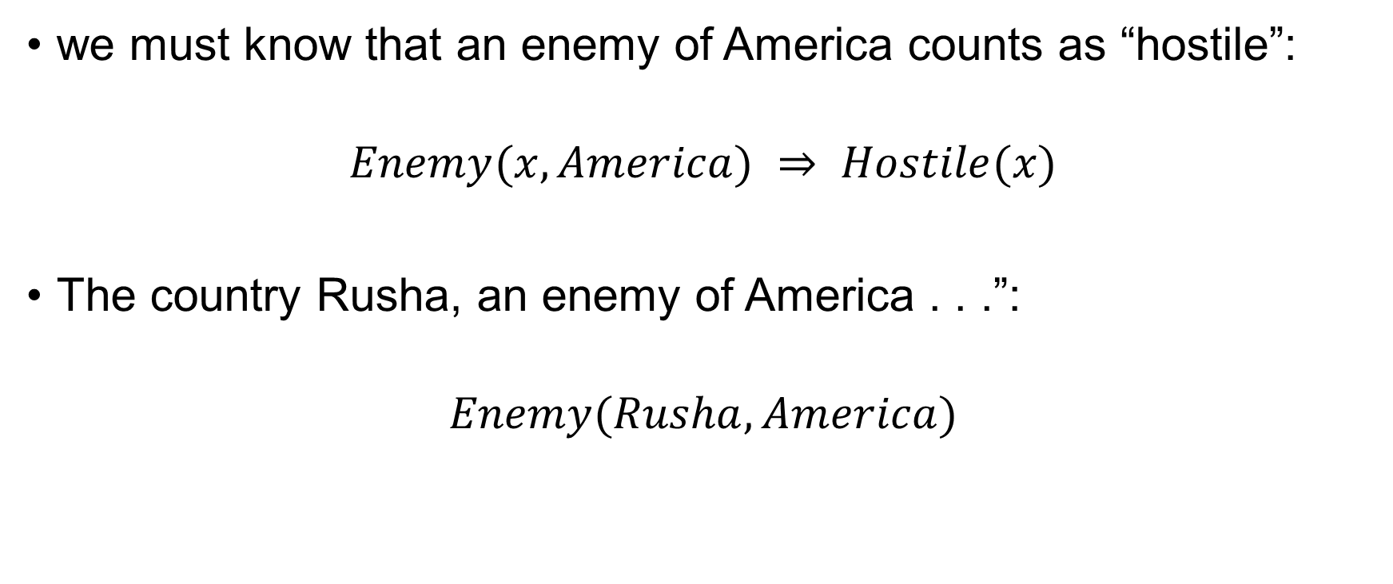
First-order definite clauses
we must know that an enemy of America counts as “hostile”:
$$Enemy(x, America) ⇒ Hostile(x)$$
The country Rusha, an enemy of America . . .”:
$$Enemy(Rusha, America)$$

Slide 27
First-order definite clauses
This KB contains no function symbols.
an instance of the class of Datalog knowledge bases.
Datalog is a language that is restricted to first-order definite clauses with no function symbols

Slide 28
A simple forward-chaining algorithm
Starting from the known facts, it triggers all the rules whose premises are satisfied, adding their conclusions to the known facts.
Let’s look at the crime problem.

Slide 29
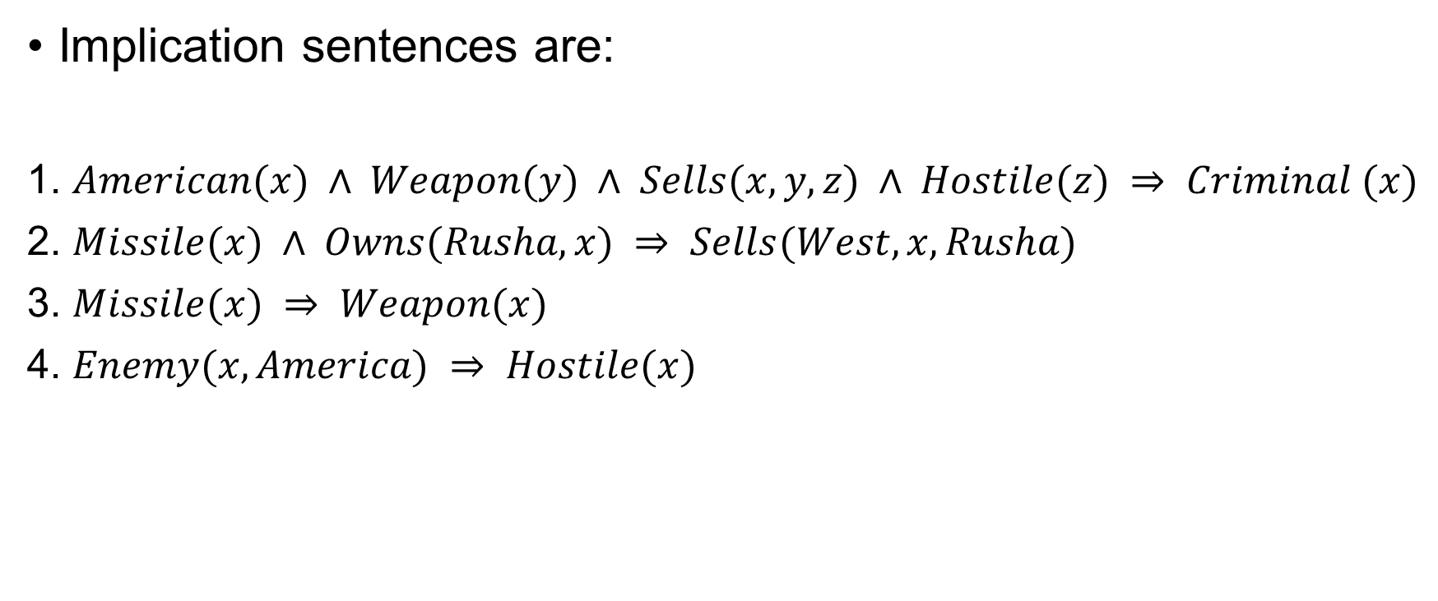
A simple forward-chaining algorithm
Implication sentences are:
1. $American(x) ∧ Weapon(y) ∧ Sells(x, y, z) ∧ Hostile(z) ⇒ Criminal (x)$
2. $Missile(x) ∧ Owns(Rusha, x) ⇒ Sells(West, x, Rusha)$
3. $Missile(x) ⇒ Weapon(x)$
4. $Enemy(x, America) ⇒ Hostile(x)$

Slide 30
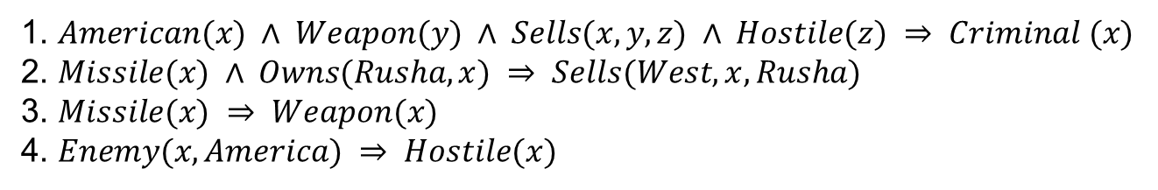
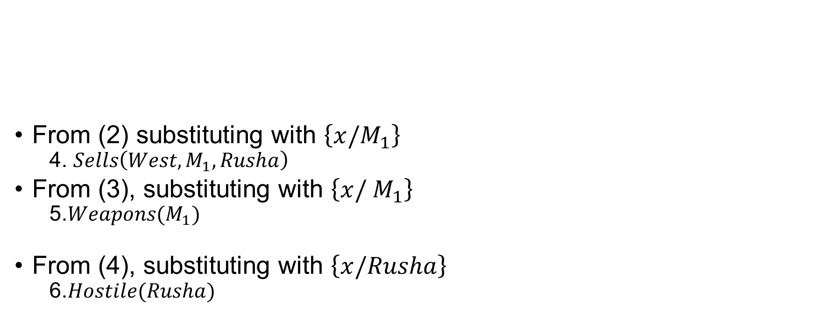
A simple forward-chaining algorithm
From (2) substituting with $\left\{x/M_{1}\right\}$
4. $Sells\left(West,M_{1}, Rusha\right)$
From (3), substituting with $\left\{x/ M_{1}\right\}$
5.$Weapons(M_{1})$
From (4), substituting with $\left\{x/Rusha\right\}$
6.$Hostile(Rusha)$
1. $American(x) ∧ Weapon(y) ∧ Sells(x, y, z) ∧ Hostile(z) ⇒ Criminal (x)$
2. $Missile(x) ∧ Owns(Rusha, x) ⇒ Sells(West, x, Rusha)$
3. $Missile(x) ⇒ Weapon(x)$
4. $Enemy(x, America) ⇒ Hostile(x)$

Slide 31

A simple forward-chaining algorithm
On the second iteration: From (1), satisfied with $\left\{x/ West, y/M_{1}, z/Rusha\right\}$ $Criminal(West)$

Slide 32
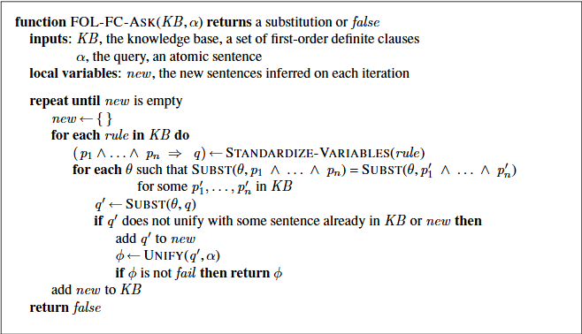
A simple forward-chaining algorithm

Slide 33
Efficient forward-chaining
There are three possible sources of inefficiency.
The “inner loop” involves finding all possible unifiers such that the premise of a rule unifies with a suitable set of facts in the knowledge base.
This is often called pattern matching and can be very expensive.
Rechecks every rule on every pattern matching iteration to see whether its premises are satisfied.
Even if very few additions are made to the knowledge base on each iteration.
Might generate many facts that are irrelevant to the goal.

Slide 34
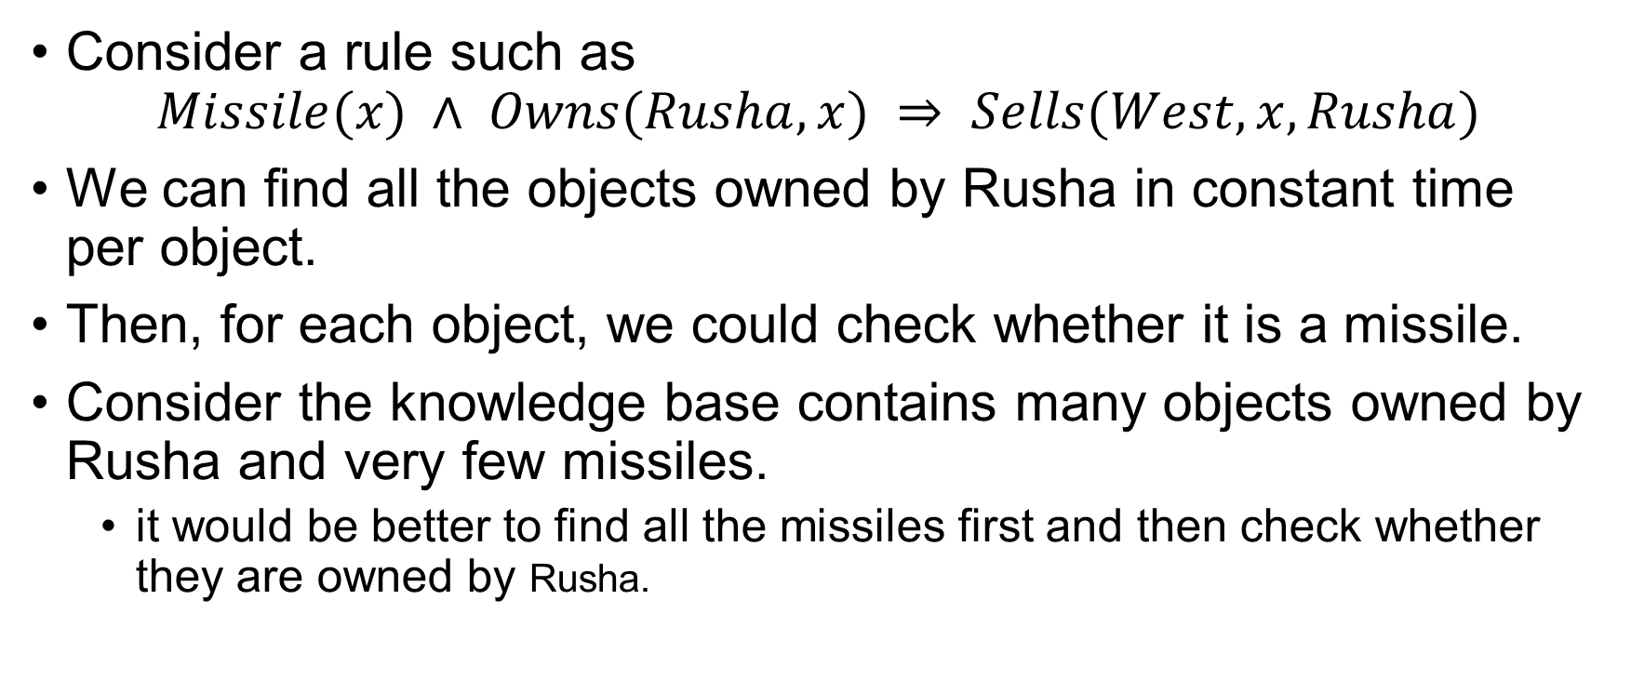
Matching rules against known facts
Consider a rule such as $Missile(x) ∧ Owns(Rusha, x) ⇒ Sells(West, x,Rusha)$
We can find all the objects owned by Rusha in constant time per object.
Then, for each object, we could check whether it is a missile.
Consider the knowledge base contains many objects owned by Rusha and very few missiles.
it would be better to find all the missiles first and then check whether they are owned by Rusha.

Slide 35
Matching rules against known facts
Conjunct ordering problem
Find an ordering to solve the conjuncts of the rule premise so that the total cost is minimized.
Finding the optimal ordering is NP-hard, but good heuristics are available.
We can apply Minimum Remaining Values.

Slide 36

Incremental forward chaining
Redundant rule matching can be avoided with an observation.
Every new fact inferred on iteration $t$ must be derived from at least one new fact inferred on iteration $t−1$.
Use indexing to keep track.

Slide 37
Irrelevant Facts
Forward chaining makes all allowable inferences based on the known facts, even if they are irrelevant to the goal at hand.
One way to avoid drawing irrelevant conclusions is to use backward chaining.

Slide 38
Backward Chaining
Work backward from the goal, chaining through rules to find known facts that support the proof.
It is used in logic programming.

Slide 39
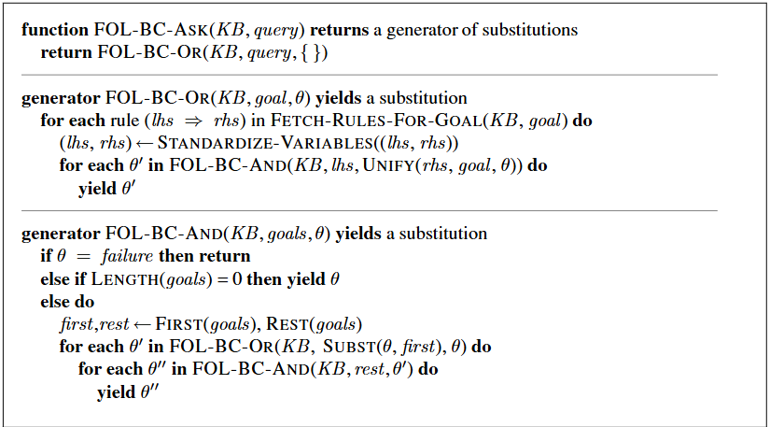
A backward-chaining Algorithm

Slide 40
A backward-chaining Algorithm
Backward chaining is a kind of AND/OR search.
The OR part because the goal query can be proved by any rule in the knowledge base.
AND part because all the conjuncts in the lhs of a clause must be proved.

Slide 41
A backward-chaining Algorithm
FOL-BC-OR works by fetching all clauses that might unify with the goal, standardizing the variables in the clause to be brand-new variables.
if the rhs of the clause does indeed unify with the goal, proving every conjunct in the lhs, using FOL-BC-AND
That function in turn works by proving each of the conjuncts in turn, keeping track of the accumulated substitution as we go.

Slide 42





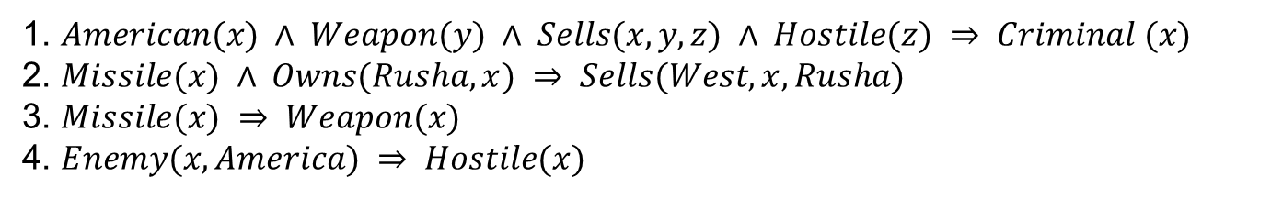




A backward-chaining Algorithm
$$Criminal \left(West\right)$$
$$American\left(West\right)$$
$$Weapon\left(y\right)$$
$$Sells\left(West, M_{1}, z\right)$$
$$Hostile\left(Rusha\right)$$
$$Missile(y)$$
$$Missile(M_{1})$$
$$Owns(Rusha, M_{1})$$
$$Enemy\left(x, America\right)$$
1. $American(x) ∧ Weapon(y) ∧ Sells(x, y, z) ∧ Hostile(z) ⇒ Criminal (x)$
2. $Missile(x) ∧ Owns(Rusha, x) ⇒ Sells(West, x, Rusha)$
3. $Missile(x) ⇒ Weapon(x)$
4. $Enemy(x, America) ⇒ Hostile(x)$
21/10/2025
42

Slide 43
Resolution
Propositional resolution using refutation is a complete inference procedure for propositional logic.
Now we will see how to extend resolution to first-order logic.

Slide 44
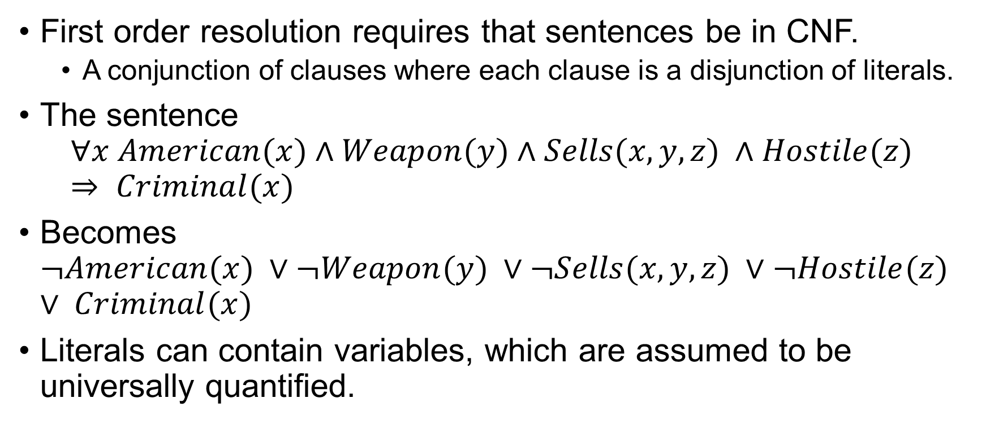
CNF for FOL
First order resolution requires that sentences be in CNF.
A conjunction of clauses where each clause is a disjunction of literals.
The sentence $∀x American(x)∧Weapon(y)∧Sells(x,y,z) ∧Hostile(z) ⇒ Criminal(x)$
Becomes $¬American(x) ∨¬Weapon(y) ∨¬Sells(x,y,z) ∨¬Hostile(z) ∨ Criminal(x)$
Literals can contain variables, which are assumed to be universally quantified.

Slide 45
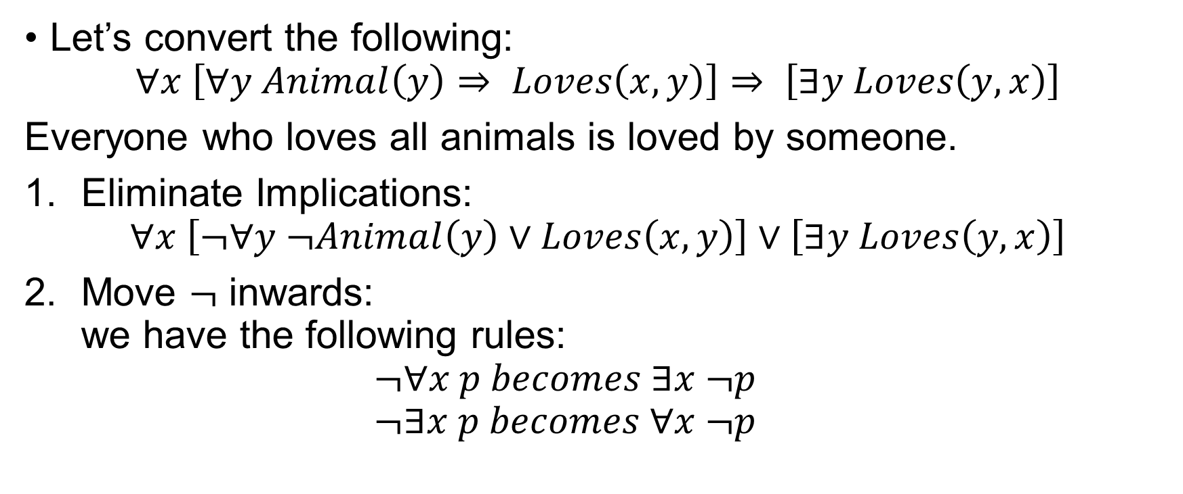
CNF of Quantifiers
Let’s convert the following:
$$∀x \left[∀y Animal\left(y\right)⇒ Loves\left(x,y\right)\right]⇒ \left[∃y Loves\left(y,x\right)\right]$$
Everyone who loves all animals is loved by someone.
Eliminate Implications: $∀x \left[¬∀y ¬Animal\left(y\right)∨Loves\left(x,y\right)\right]∨\left[∃y Loves\left(y,x\right)\right]$
Move $¬$ inwards: we have the following rules: $¬∀x p becomes ∃x ¬p$ $¬∃x p becomes ∀x ¬p$

Slide 46

CNF of Quantifiers
Our sentence goes through the following: $∀x \left[∃y ¬\left(¬Animal\left(y\right)∨Loves\left(x,y\right)\right)\right]∨\left[∃y Loves\left(y,x\right)\right]$ $∀x \left[∃y ¬¬Animal\left(y\right)∧¬Loves\left(x,y\right)\right]∨\left[∃y Loves\left(y,x\right)\right]$ $∀x \left[∃y Animal\left(y\right)∧¬Loves\left(x,y\right)\right]∨\left[∃y Loves\left(y,x\right)\right]$

Slide 47

CNF of Quantifiers
3. Standardize variables: Change variable names to avoid confusions. $$∀x [∃y Animal(y)∧¬Loves(x,y)] ∨[∃z Loves(z,x)]$$

Slide 48
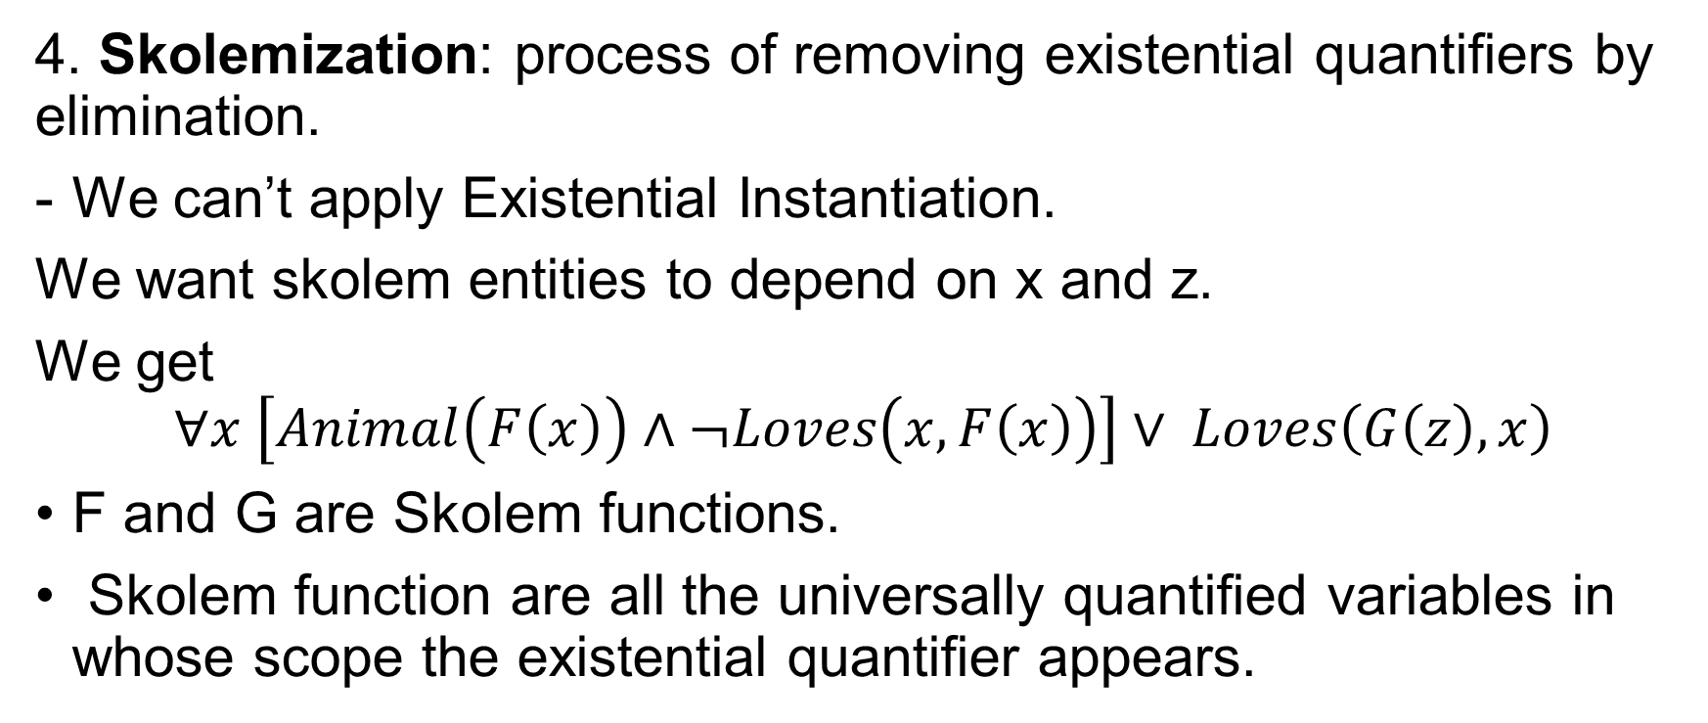
CNF of Quantifiers
4. Skolemization: process of removing existential quantifiers by elimination.
We can’t apply Existential Instantiation.
We want skolem entities to depend on x and z.
We get
$$∀x \left[Animal\left(F\left(x\right)\right)∧¬Loves\left(x,F\left(x\right)\right)\right]∨ Loves\left(G\left(z\right),x\right)$$
F and G are Skolem functions.
Skolem function are all the universally quantified variables in whose scope the existential quantifier appears.

Slide 49
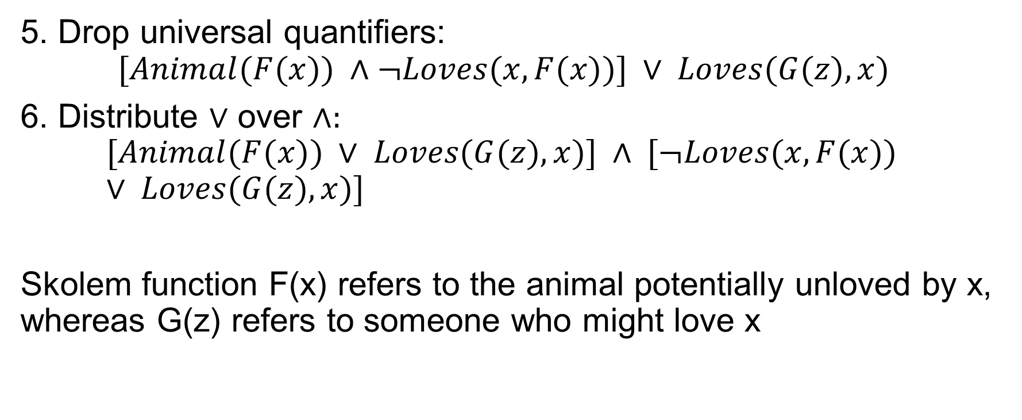
CNF of Quantifiers
5. Drop universal quantifiers: $$[Animal(F(x)) ∧¬Loves(x,F(x))] ∨ Loves(G(z),x)$$
6. Distribute $∨$ over $∧:$
$$[Animal(F(x)) ∨ Loves(G(z),x)] ∧ [¬Loves(x,F(x)) ∨ Loves(G(z),x)]$$
Skolem function F(x) refers to the animal potentially unloved by x, whereas G(z) refers to someone who might love x

Slide 50
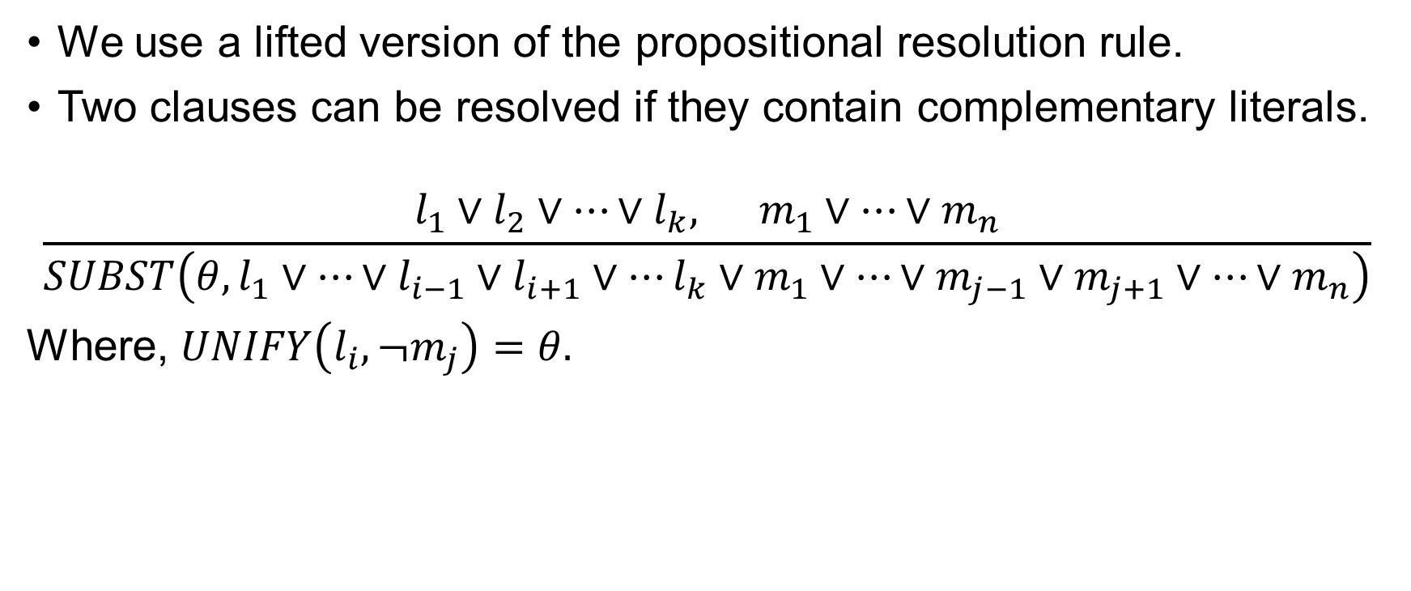
The Resolution Inference Rule
We use a lifted version of the propositional resolution rule.
Two clauses can be resolved if they contain complementary literals.
$$\frac{l_{1}∨l_{2}∨…∨l_{k}, m_{1}∨…∨m_{n}}{SUBST\left(θ,l_{1}∨…∨l_{i−1}∨l_{i+1}∨…l_{k}∨m_{1}∨…∨m_{j−1}∨m_{j+1}∨…∨m_{n}\right)}$$
Where, $UNIFY\left(l_{i},¬m_{j}\right)=θ.$

Slide 51
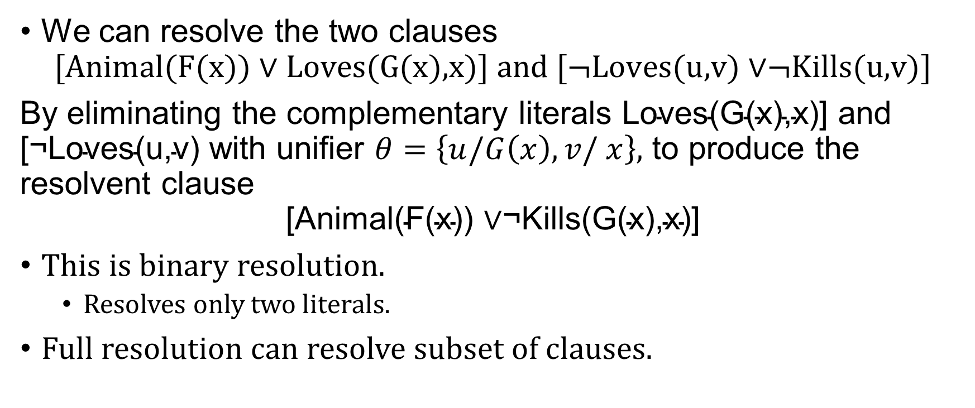
The Resolution Inference Rule
We can resolve the two clauses $\text{[}\text{Animal}\text{(}\text{F}\text{(}\text{x}\text{)) }\text{∨ }\text{Loves}\text{(}\text{G}\text{(}\text{x}\text{),}\text{x}\text{)] }\text{and}\text{ [¬}\text{Loves}\text{(}\text{u}\text{,}\text{v}\text{) }\text{∨}\text{¬}\text{Kills}\text{(}\text{u}\text{,}\text{v}\text{)]}$
By eliminating the complementary literals $\text{Loves}\text{(}\text{G}\text{(}\text{x}\text{),}\text{x}\text{)] }\text{and} \text{[¬}\text{Loves}\text{(}\text{u}\text{,}\text{v}\text{) }$with unifier $θ=\left\{u/G\left(x\right), v/ x\right\},$ to produce the resolvent clause $$\text{[}\text{Animal}\text{(}\text{F}\text{(}\text{x}\text{)) }\text{∨}\text{¬}\text{Kills}\text{(}\text{G}\text{(}\text{x}\text{),}\text{x}\text{)]}$$
This is binary resolution.
Resolves only two literals.
Full resolution can resolve subset of clauses.

Slide 52
The Resolution Inference Rule
An alternative approach is to extend factoring.
First-order factoring reduces two literals if they are unifiable.

Slide 53
Example Proof
Resolution proves that KB |= α by proving KB ∧¬α unsatisfiable, that is, by deriving the empty clause.
Consider the crime example.
We first convert the sentences to CNF.

Slide 54
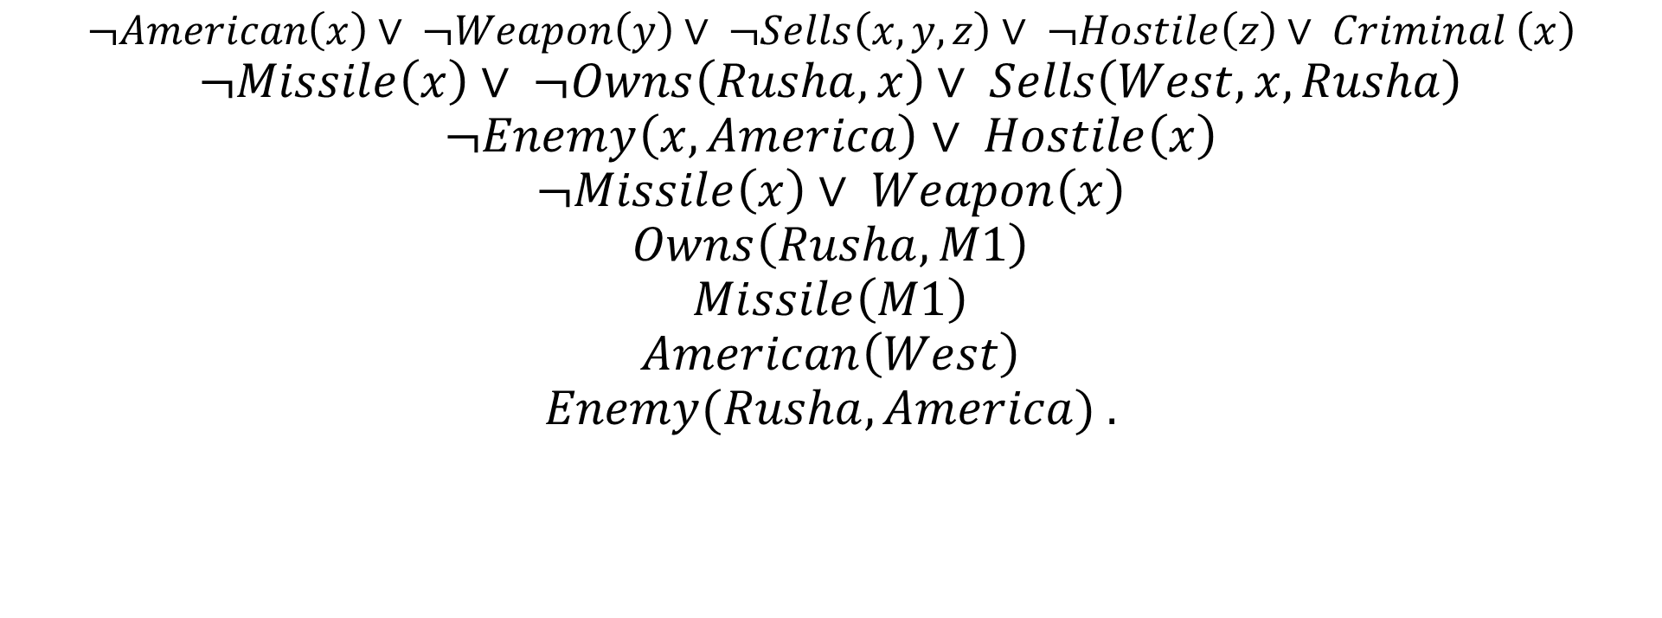
CNFs for Criminal Example
$$¬American\left(x\right)∨ ¬Weapon\left(y\right)∨ ¬Sells\left(x, y, z\right)∨ ¬Hostile\left(z\right)∨ Criminal \left(x\right)$$
$$¬Missile\left(x\right)∨ ¬Owns\left(Rusha, x\right)∨ Sells\left(West, x, Rusha\right)$$
$$¬Enemy\left(x, America\right)∨ Hostile\left(x\right)$$
$$¬Missile\left(x\right)∨ Weapon\left(x\right)$$
$$Owns\left(Rusha, M1\right)$$
$$Missile\left(M1\right)$$
$$American\left(West\right)$$
$$Enemy(Rusha, America) .$$

Slide 55











Proof
$$¬American\left(x\right)∨ ¬Weapon\left(y\right)∨ ¬Sells\left(x, y, z\right)∨ ¬Hostile\left(z\right)∨ Criminal \left(x\right)$$
$$¬ Criminal \left(x\right)$$
$$American\left(West\right)$$
$$¬American\left(West\right)∨ ¬Weapon\left(y\right)∨ ¬Sells\left(West, y, z\right)∨ ¬Hostile\left(z\right)$$
$$¬Missile\left(x\right)∨ Weapon\left(x\right)$$
$$¬Weapon\left(y\right)∨ ¬Sells\left(West, y, z\right)∨ ¬Hostile\left(z\right)$$
$$Missile(M_{1})$$
$$¬Missile\left(y\right)∨ ¬Sells\left(West, y, z\right)∨ ¬Hostile\left(z\right)$$
$$¬Missile\left(x\right)∨ ¬Owns\left(Rusha, x\right)∨ Sells\left(West, x, Rusha\right)$$
$$¬Sells\left(West, M_{1}, z\right)∨ ¬Hostile\left(z\right)$$
$$Missile(M_{1})$$
$$¬Missile\left(M_{1}\right)∨ ¬Owns\left(Rusha, M_{1}\right)∨¬Hostile\left(Rusha\right)$$
$$Owns(Rusha, M_{1})$$
$$¬Owns\left(Rusha, M_{1}\right)∨¬Hostile\left(Rusha\right)$$
$$¬Enemy\left(x, America\right)∨ Hostile\left(x\right)$$
$$¬Hostile\left(Rusha\right)$$
$$Enemy\left(x, America\right)$$
$$¬Enemy\left(x, America\right)$$

Slide 56
Another Example
In English, the problem is as follows:
Everyone who loves all animals is loved by someone.
Anyone who kills an animal is loved by no one.
Jack loves all animals.
Either Jack or Curiosity killed the cat, who is named Tuna.
Did Curiosity kill the cat?

Slide 57
Another Example
First, we express the original sentences, some background knowledge, and the negated goal G in first-order logic:
A. ∀ x [∀ y Animal (y) ⇒ Loves(x, y)] ⇒ [∃ y Loves(y, x)]
B. ∀ x [∃ z Animal (z) ∧ Kills(x, z)] ⇒ [∀ y ¬Loves(y, x)]
C. ∀ x Animal(x) ⇒ Loves(Jack , x)
D. Kills(Jack , Tuna) ∨ Kills(Curiosity, Tuna)
E. Cat(Tuna)
F. ∀ x Cat(x) ⇒ Animal (x)
¬G. ¬Kills(Curiosity, Tuna)

Slide 58
Another Example
Next we apply the conversion procedure to get CNF.
A1. Animal(F (x)) ∨ Loves(G(x), x)
A2. ¬Loves(x, F (x)) ∨ Loves(G(x), x)
B. ¬Loves(y, x) ∨ ¬Animal (z) ∨ ¬Kills(x, z)
C. ¬Animal(x) ∨ Loves(Jack , x)
D. Kills(Jack , Tuna) ∨ Kills(Curiosity, Tuna)
E. Cat(Tuna)
F. ¬Cat(x) ∨ Animal (x)
¬G. ¬Kills(Curiosity, Tuna)

Slide 59














Proof
$$Cat \left(Tuna\right)$$
$$\text{¬}\text{Cat}\text{(}\text{x}\text{) }\text{∨ }\text{Animal}\text{ (}\text{x}\text{)}$$
$$\text{Kills}\text{(}\text{Jack}\text{ , }\text{Tuna}\text{) }\text{∨ }\text{Kills}\text{(}\text{Curiosity}\text{, }\text{Tuna}\text{))}$$
$$\text{¬}\text{Kills}\text{(}\text{Curiosity}\text{, }\text{Tuna}\text{)}$$
$$\text{Animal}\text{ (}\text{Tuna}\text{)}$$
$$\text{¬}\text{Loves}\text{(}\text{y}\text{, }\text{x}\text{) }\text{∨ }\text{¬}\text{Animal}\text{ (}\text{z}\text{) }\text{∨ }\text{¬}\text{Kills}\text{(}\text{x}\text{, }\text{z}\text{)}$$
$$\text{Kills}\text{(}\text{Jack}\text{ , }\text{Tuna}\text{)}$$
$$\text{¬}\text{Loves}\text{(}\text{x}\text{, }\text{F}\text{ (}\text{x}\text{)) }\text{∨ }\text{Loves}\text{(}\text{G}\text{(}\text{x}\text{), }\text{x}\text{)}$$
$$\text{¬}\text{Animal}\text{(}\text{x}\text{)}\text{∨}\text{Loves}\text{(}\text{Jack}\text{,}\text{x}\text{)}$$
$$\text{¬}\text{Loves}\text{(}\text{y}\text{, }\text{x}\text{) }\text{∨ }\text{¬}\text{Kills}\text{(}\text{x}\text{, }\text{Tuna}\text{)}$$
$$\text{¬}\text{Animal}\text{(}\text{F}\text{ (}\text{John}\text{)) }\text{∨ }\text{Loves}\text{(}\text{G}\text{(}\text{Jack}\text{), }\text{Jack}\text{)}$$
$$\text{Animal}\text{(}\text{F}\text{ (}\text{x}\text{)) }\text{∨ }\text{Loves}\text{(}\text{G}\text{(}\text{x}\text{), }\text{x}\text{)}$$
$$¬\text{Loves}\text{(}\text{y}\text{, }\text{Jack}\text{)}$$
$$\text{Loves}\text{(}\text{G}\text{(}\text{Jack}\text{), }\text{Jack}\text{)}$$

Slide 60
A Different Question
The proof answers the question “Did Curiosity kill the cat?”
But “Who killed the cat?” – how will you answer this?
Finding out who killed the cat is just a matter of keeping track of the bindings for the query variables in the proof.

Slide 61

Equality
How can we handle assertion of the form $x=y?$
3 approach.
Axiom.
Demodulation.
Extended unification algorithm.

Slide 62
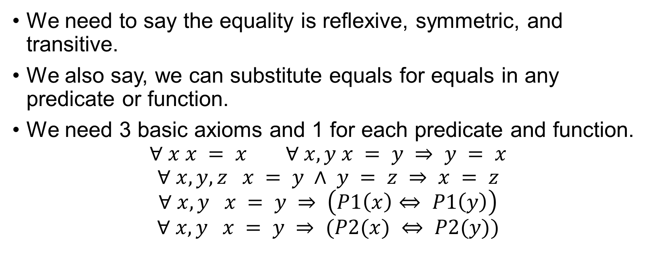
Axiomatize Equality
We need to say the equality is reflexive, symmetric, and transitive.
We also say, we can substitute equals for equals in any predicate or function.
We need 3 basic axioms and 1 for each predicate and function. $∀ x x = x ∀ x, y x = y ⇒ y = x$
$$∀ x, y, z x = y ∧ y = z ⇒ x = z$$
$$∀ x, y x = y ⇒ \left(P1\left(x\right)⇔ P1\left(y\right)\right)$$
$$∀ x, y x = y ⇒ (P2(x) ⇔ P2(y))$$

Slide 63
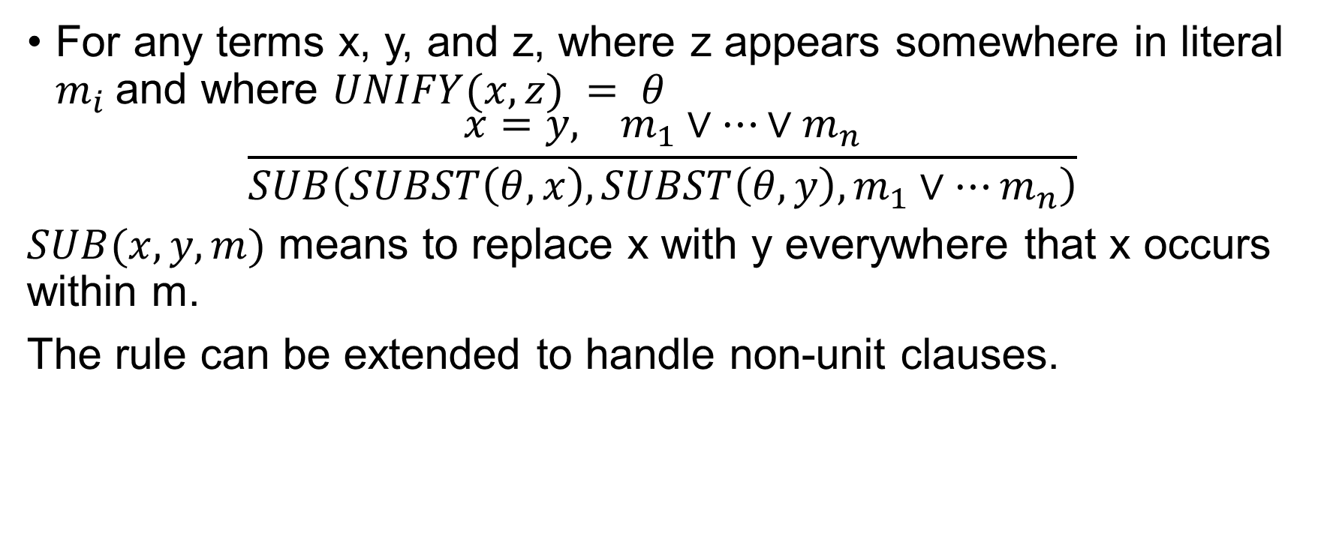
Demodulation
For any terms x, y, and z, where z appears somewhere in literal $m_{i}$and where $UNIFY(x, z) = θ$
$$\frac{x=y, m_{1}∨…∨m_{n}}{SUB\left(SUBST\left(θ,x\right), SUBST\left(θ,y\right), m_{1}∨…m_{n}\right)}$$
$SUB(x,y,m)$ means to replace x with y everywhere that x occurs within m.
The rule can be extended to handle non-unit clauses.

Slide 64
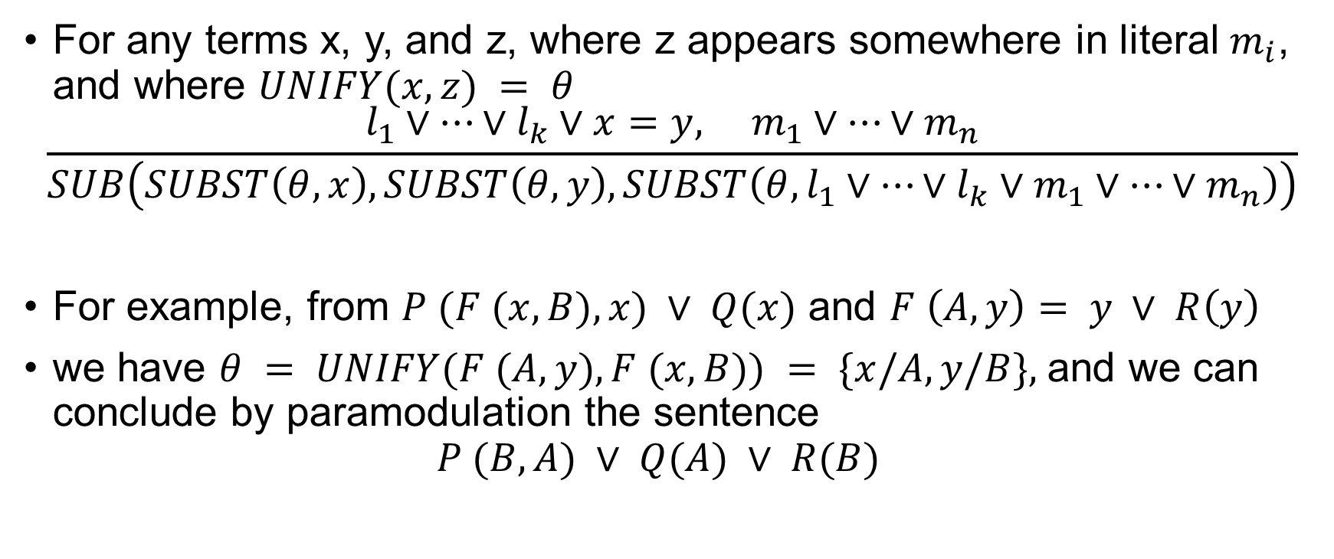
Paramodulation
For any terms x, y, and z, where z appears somewhere in literal $m_{i}$, and where $UNIFY(x, z) = θ$
$$\frac{l_{1}∨…∨l_{k}∨x=y, m_{1}∨…∨m_{n}}{SUB\left(SUBST\left(θ,x\right), SUBST\left(θ, y\right), SUBST\left(θ, l_{1}∨…∨l_{k}∨m_{1}∨…∨m_{n}\right)\right)}$$
For example, from $P (F (x, B), x) ∨ Q(x)$ and $F \left(A, y\right)= y ∨ R\left(y\right)$
we have $θ = UNIFY(F (A, y), F (x, B)) = \{x/A, y/B\},$and we can conclude by paramodulation the sentence $P (B, A) ∨ Q(A) ∨ R(B)$

Slide 65
Resolution Strategies
Unit Preference
Use sentence that has a single literal.
Always produces shorter clause.
Set of Support
It is effective to try to eliminate some potential resolutions.
We start with a small set and add the resolvents into it.
Need to be careful with the set selection.

Slide 66
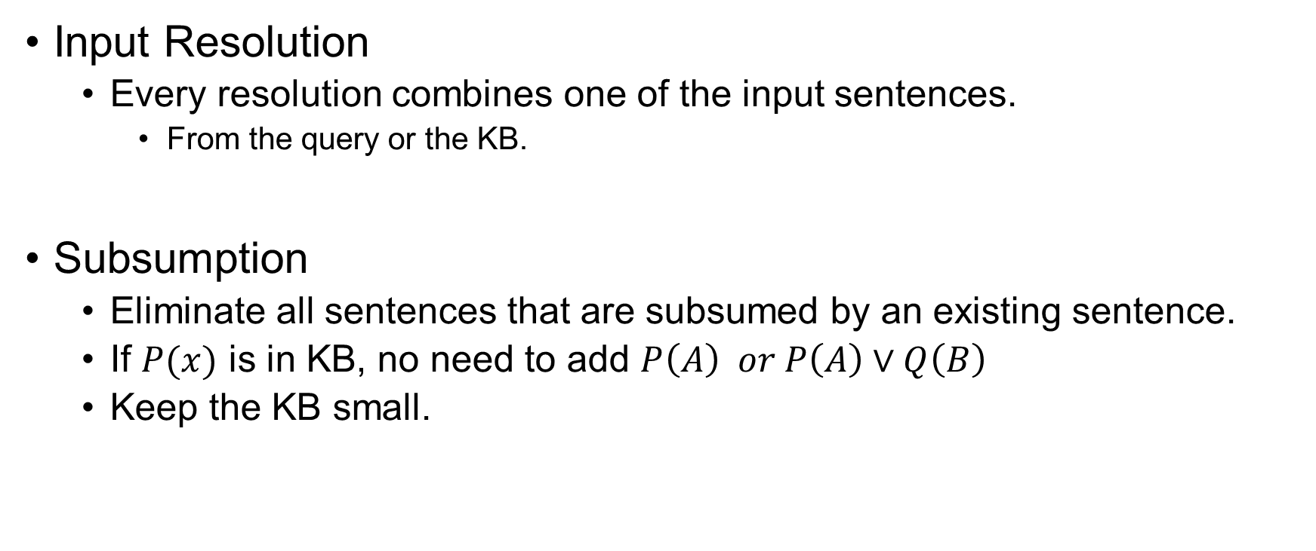
Resolution Strategies
Input Resolution
Every resolution combines one of the input sentences.
From the query or the KB.
Subsumption
Eliminate all sentences that are subsumed by an existing sentence.
If $P(x)$ is in KB, no need to add $P\left(A\right) or P\left(A\right)∨Q\left(B\right)$
Keep the KB small.

Slide 67
Thank You.

